Slide 1
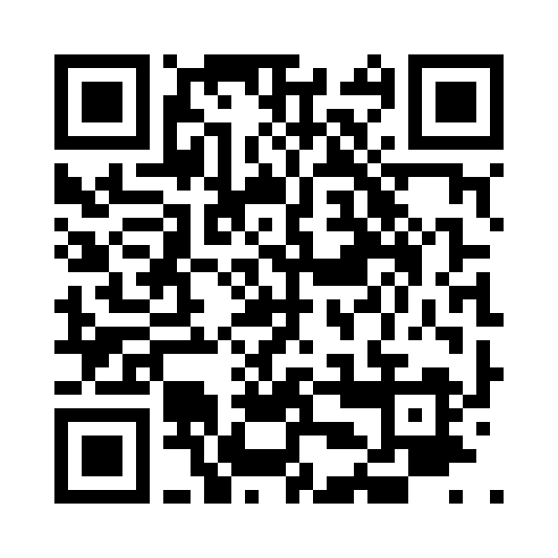
The Edge of Reason Azure IoT Edge
Dave Glover | Microsoft Australia | Cloud Developer Advocate
github.com/gloveboxes | @dglover | Microsoft Docs

Slide 2





Get started quickly with Azure IoT
Solutions
Platform Services
Edge
Azure IoT Central
Azure IoT solution accelerators
Azure IoT Hub
Azure IoT Hub Device Provisioning Service
Azure Time Series Insights
Azure Maps
Azure IoT Edge
Experience the simplicity of SaaS for IoT, with no cloud expertise required
Create fully customizable solutions with templates for common IoT scenarios
Connect, monitor and manage billions of IoT assets
Zero-touch, just-in-time provisioning of devices to the right IoT hub
Explore and analyze time-series data from IoT devices
Add maps, search, routing and other location insights to your apps
Extend cloud intelligence and analytics to edge devices

Slide 3
Comprehensive Set of Capabilities for IoT Solutions
Azure IoT Central
IoT SaaS
SaaS
Solutions
Azure IoT solution accelerators
PaaS
remote monitoring
predictive maintenance
connected factory
device simulation
Device Support
Edge Support
IoT Services
Data & Analytics Services
Visualization & Integration Services
Azure IoT Device SDK
Azure IoT Edge
Azure IoT Hub
Azure Stream Analytics
Azure HD Insight
Microsoft Flow
Microsoft Power BI
Services
PaaS Services &
Device Support
Certified Devices
Azure Certified for IoT
Azure IoT Hub Device Provisioning Service
Azure Time Series Insights
Azure Event Hubs
Azure Logic Apps
Azure Active Directory
Security Program for Azure IoT
Azure Machine Learning
Azure Data Lake Analytics
Notification Hubs
Azure Monitor
Windows 10 IoT Core
Cosmos DB
Azure Data Lake
Azure Websites

Slide 4
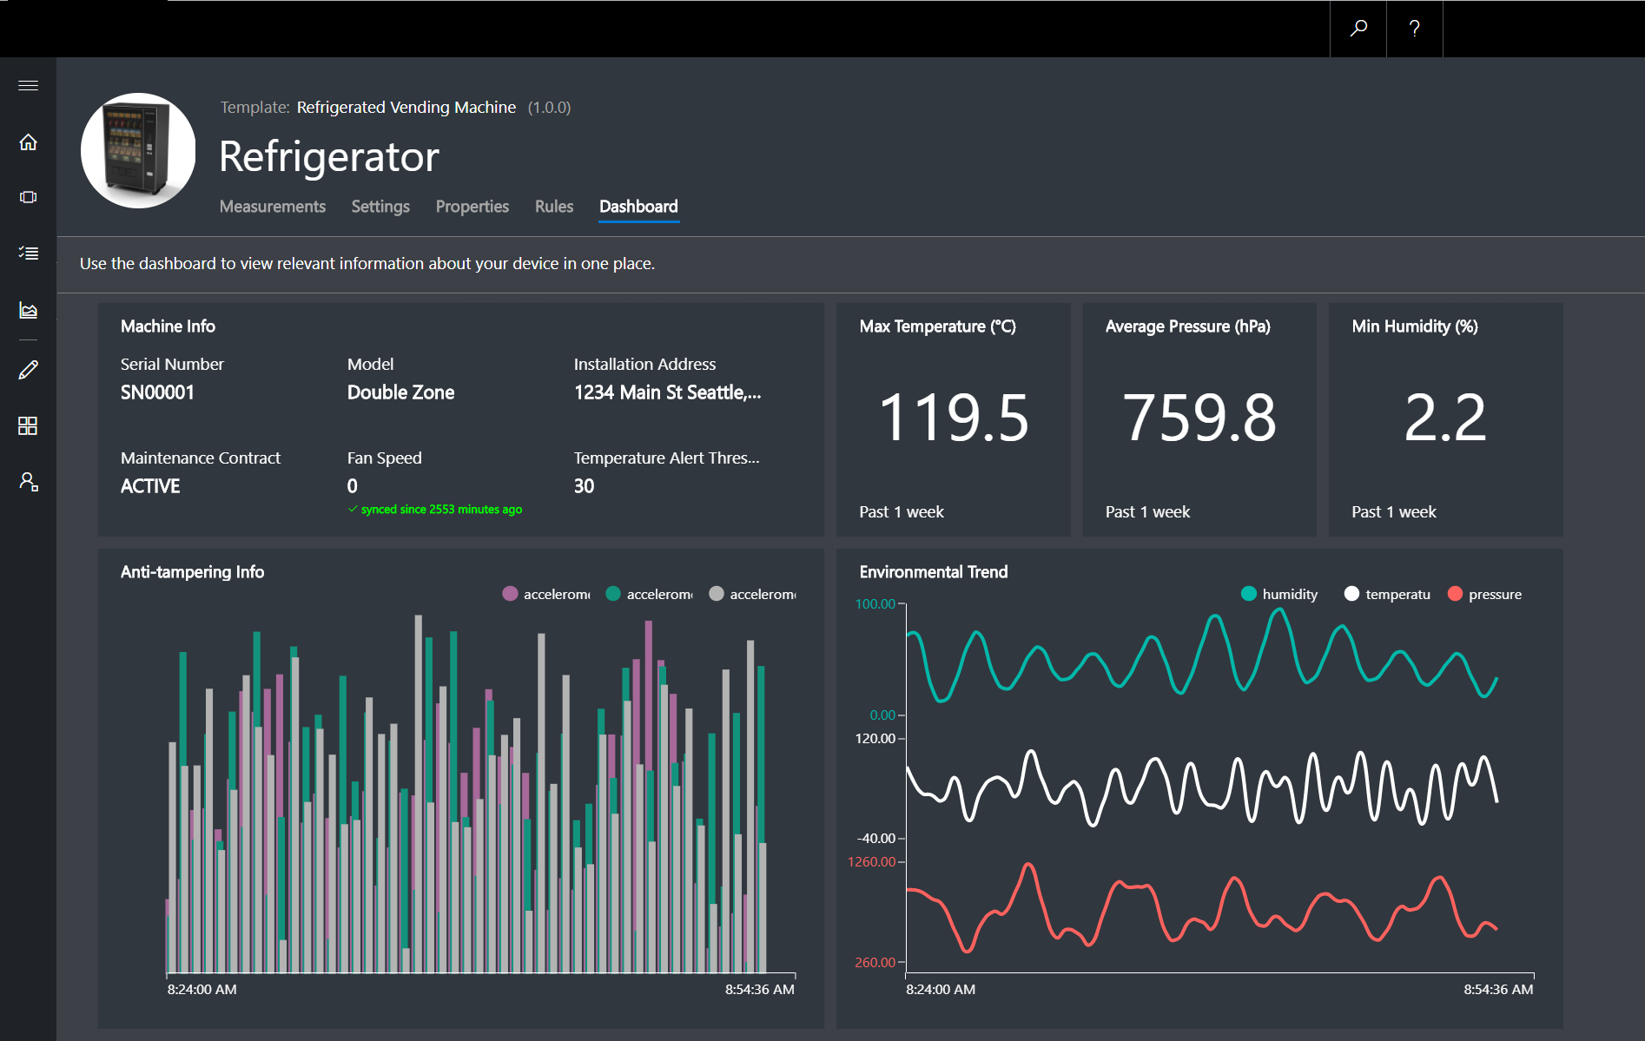
Azure IoT Central
Device Connectivity & Management
Telemetry Ingestion and Command & Control
Monitoring Rules & Triggered Actions
User roles and permissions
Dashboards, Visualization & Insights
Fully Hosted & Managed by Microsoft

Slide 5
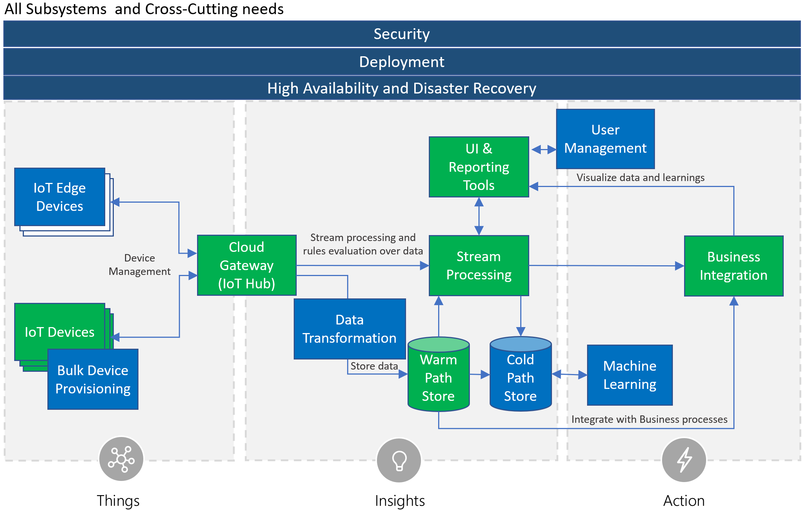
Azure IoT Reference Architecture
Notes:
Speaker notes:
At the core an IoT application consists of the following subsystems: 1) devices (and/or on premise edge gateways) that have the ability to securely register with the cloud, and connectivity options for sending and receiving data with the cloud, 2) a cloud gateway service, or hub, to securely accept that data and provide device management capabilities, 3) stream processors that consume that data, integrate with business processes, and place the data into storage, and 4) a user interface to visualize telemetry data and facilitate device management.

Slide 6

Azure Sphere is an end-to-end solution for securing MCU powered devices and empowers manufacturers to create highly-secured, connected MCU devices
A new Azure Sphere OS secured by Microsoft for the devices 10-year lifetime to create a trustworthy platform for new IoT experiences
A new Azure Sphere class of MCUs, from silicon partners, with built-in Microsoft security technology provide connectivity and a dependable hardware root of trust.
The Azure Sphere Security Service guards every Azure Sphere device; it brokers trust for device-to-device and device-to-cloud communication, detects emerging threats, and renews device security.
SECURITY
Every device built with Azure Sphere is secured by Microsoft.
For its 10 year lifetime.
PRODUCTIVITY
The Azure Sphere developer experience shortens OEM time to market.
OPPORTUNITY
Azure Sphere empowers OEMs to create new customer experiences and business models.
Notes:
We’re pleased to tell you about Azure Sphere. Azure Sphere is an end-to-end solution for creating highly-secured connected MCU devices.
The Azure Sphere platform consist of 3 elements. The first element of the Azure Sphere platform is a new class of secured MCUs. This new class of MCUs from our silicon partners offer built-in connectivity, powerful crossover processors, and Microsoft security technology to provide secured hardware.
The second element of the Azure Sphere platform is a secured operating system. This new, highly-secured operating system is purpose-built for use in IoT devices and combined the best of Microsoft and OSS technologies to create a trustworthy platform for new IoT experiences.
The third element of the Azure Sphere platform is a cloud service. This Azure Sphere Security Service guards every Azure Sphere device. It provides each Azure Sphere device with ongoing security support in the form of software updates, ecosystem-wide detection of emerging security threats, and certificate-based brokering of trust for device-to-device and device-to-cloud communication.
Working in concert, Azure Sphere MCUs, the Azure Sphere IoT OS, and the Azure Sphere Security Service create and end-to-end solution for creating highly-secured, connected MCU devices.

Slide 7
Shift to the edge
Cloud
Globally available, unlimited compute resources
IoT
Harnessing signals from sensors and devices, managed centrally by the cloud
Edge
Intelligence offloaded from the cloud to IoT devices
AI
Breakthrough intelligence capabilities, in the cloud and on the edge

Slide 8
Azure IoT Hub in the Cloud and on the Edge
Azure IoT Hub in the Cloud
Internet Scale Device Support
Remote monitoring and management
Infinite Compute and Storage for Workloads such a Machine Learning & LOB
Azure IoT Edge
Low latency requiring near real-time response
Large quantities of data eg Image processing
Protocol translation & data normalization

Slide 9
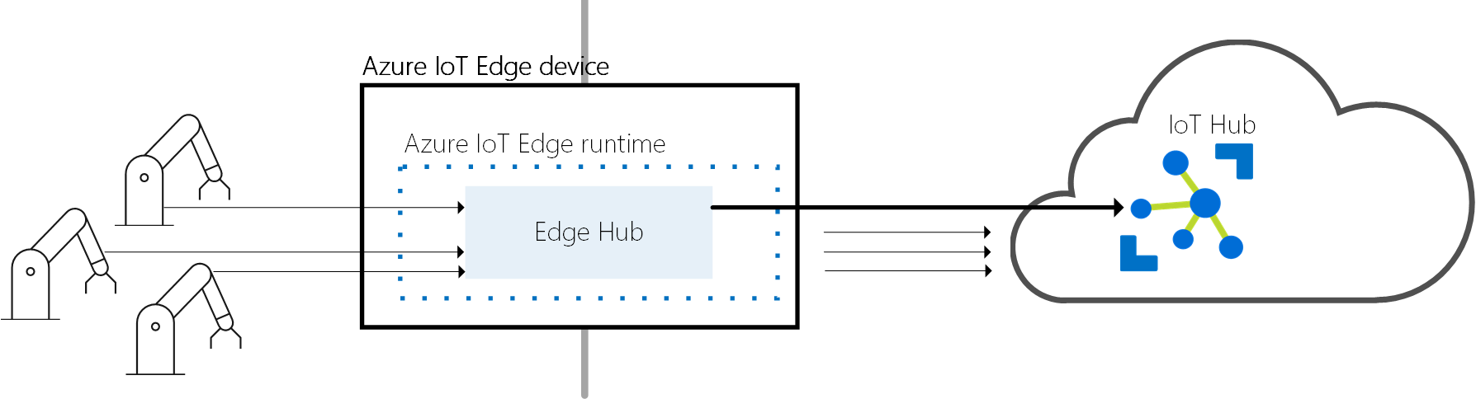
Azure IoT Edge Design Principles
Extends Azure IoT Hub to the Edge
End to End Security (with TPM)
Central Health Monitoring & Reporting
Application Life Cycle Management
Local & Cloud Message Services
Store and Forward & Gateway Services
Linux and Windows Support
Open Source Runtime (MIT)

Slide 10

Azure IoT Edge Development
Cross-platform
Develop on Windows, Mac and Linux with Visual Studio Code
SDKs for C#, Python, Java, and Node.js
Target IoT Edge on Linux (x64 & ARM), Windows (x64)
Extensible
Your Custom Code
Microsoft 1st Party Modules - Azure Functions, Stream Analytics, Machine Learning
3rd Party Modules Marketplace
Unit of deployment is a Docker Image
Azure Container Registry, Docker Hub
Notes:
10

Slide 11
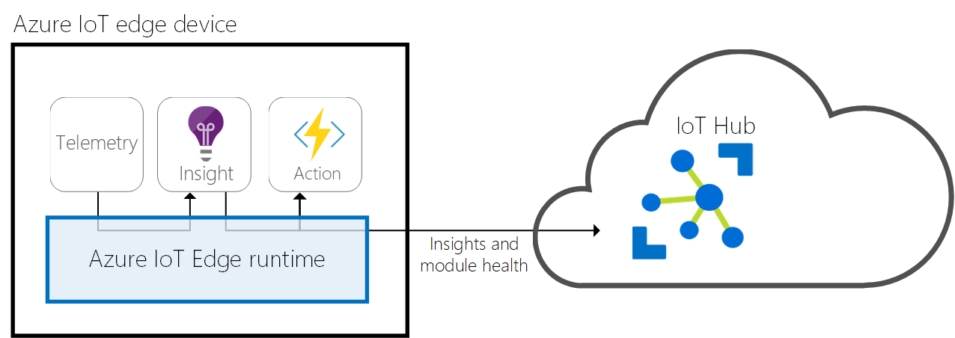
IoT Edge Runtime Concepts
Modules = Docker Containers
Device Twins = Reported & Desired State
Routes = define message paths

Slide 12
Concept - Routing
Edge Runtime
mod1
inputs/in1
FROM <source> WHERE <condition> INTO <sink>
Sources – source of messages
/messages/modules/{mid}/outputs/{out1}
Condition – expression on messages properties/body
sensorType = “temp” and alert = true
Sinks – destination for messages (endpoints)
$upstream
brokeredEndpoint(“/modules/{mid}/inputs/{in1}”)
For example:
FROM /messages/modules/mod1/outputs/*
WHERE sensorType = “temp”
INTO brokeredEndpoint(“/modules/mod2/inputs/in1”)
outputs/out1
mod2
inputs/in1
outputs/out1
$upstream
Query Language
Notes:
12

Slide 13

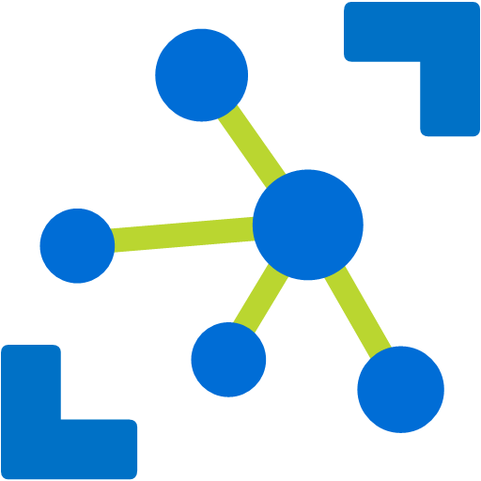
Concept – Device Management
Query
Power plant
IoT Edge or device
Device twin
Device twin
Elevators
Desired
Desired
Reported
Reported
Smart meters
Tags
Methods
IoT Hub
Methods
Medical devices
Jobs
Buildings
Schedule and broadcast Device twin changes across large fleets
Notes:
The following is a high-level illustration of how a firmware update pattern is performed leveraging IoT Hub.
The back end application initiates the firmware update (using a method call). The FW update handler app on the devices returns a response that the update command was received.
**SPEAK TO** If updating many devices, a job can be used to schedule the update process for many devices at a particular time.
The FW update handler downloads the firmware image from the URI provided by the method call. It reports completion of this step by updating the device twin.
The back end application dash board sends a query to the twin and updates to show the FW image was successfully downloaded to the device.
The FW update handler begins the firmware update process and reports this by updating the device twin.
The back end application dashboard sends a query to the twin and updates to show the FW update process has begun.
The FW update handler completes the FW update & reboot, reconnects to IoT Hub, and updates a the device twin to indicate the process has been completed.

Slide 14

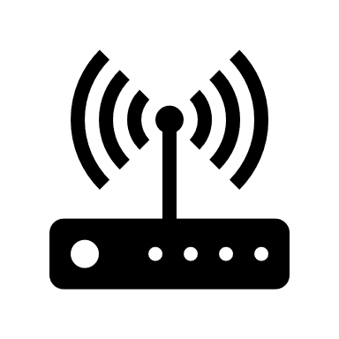




Azure IoT Edge in Action
Develop your Container Workloads
Upload Modules to a Container Registry
Provision IoT Edge Device Agents
Select Device/Deployment Set
Define Modules
Define Message Routes
Define Module Parameters
Container Registry
Azure IoT Hub
IoT Edge
Container
Module
Container
Module
Container
Module
Container
Module
Module Twin
Device Twin
Module
Routes
Edge runtime
Local storage
Device Provisioning
Security Manager
Secure Boot
Secure Storage
Hardware based root of trust

Slide 15
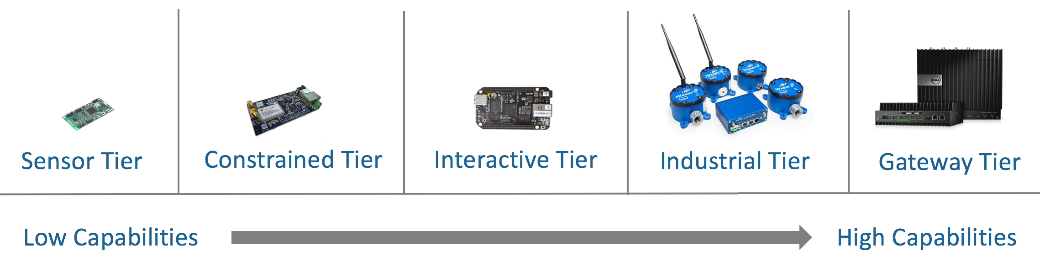
Hardware for Azure IoT Edge
Linux and Windows supported on x64 and ARM (support for containers required)
Hardware sizing dependent on workloads
Internal tests on devices as small as Raspberry Pi 3 with four containers (on Linux)
Notes:
15

Slide 16
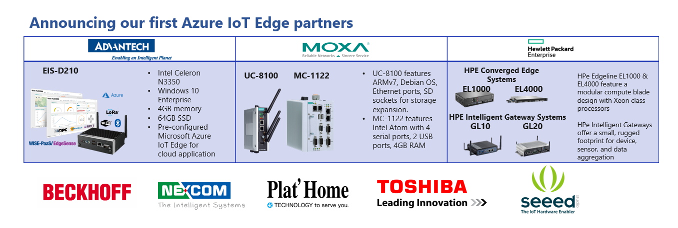
Certified hardware for Azure IoT Edge
Azure IoT Edge certification requirements
Core requirements for functional areas: AI, Device Management, and Security
Additional functional areas to be added
HW partners and OEMs welcome to join
Send email to iotcertdisc@microsoft.com
catalog.azureiotsuite.com
Notes:
New certification framework:
Each block = capability has its own requirements and N # of levels
MSFT can continue to add certifications for capabilities as necessary
Update cadence will align with each semester
Edge runtime: Level 1 only
AI capability: Level 1 or 2
Device Management capability: Level 1 only
Security capability: Level 1-4
16

Slide 17
Azure IoT Edge Development Cognitive Services Vision
Azure Container Registry
Azure
IoT Hub
Custom
Code
(video collection)
Azure Cognitive Services
Azure Speech Servces
IoT Edge
Device
(Raspberry Pi)
Deployment Manifest
Docker
Container
Docker
Container
Docker
Container
Video Camera

Slide 18
Demo: Retail for Visual Impaired People
Azure IoT Hub, Azure Custom Vision, Bing Speech, Visual Studio Code
https://github.com/gloveboxes/Creating-an-image-recognition-solution-with-Azure-IoT-Edge-and-Azure-Cognitive-Services

Slide 19
Developing Modules
Device Simulator for parallel development
Follow Azure IoT Edge Tutorials
Productivity Tips
Build/Test as much as you can on your development machine
Install localhost:5000 Docker Registry
docker run -d -p 5000:5000 --restart=always --name registry registry:2
The Deploy to IoT Edge Device
Use lowercase names for modules
Custom Vision Training Tips

Slide 20
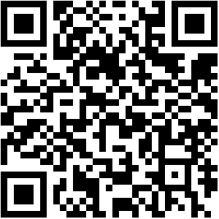
AI on Azure IoT Edge
Follow me on @dglover
dglover@microsoft.com

Slide 21
Resources
Demo source code https://github.com/gloveboxes/NDC2018-Azure-IoT-Edge-Image-Analysis-with-Bing-Text-to-Speech
What’s new with Azure IoT Edge https://azure.microsoft.com/en-au/blog/what-s-new-with-azure-iot-edge
Azure IoT Edge on Microsoft Docs https://docs.microsoft.com/en-us/azure/iot-edge
Azure IoT Edge Blog https://azure.microsoft.com/en-us/blog/tag/azure-iot-edge
Microsoft Docs https://docs.microsoft.com
Certified Azure IoT Hardware https://azure.microsoft.com/en-au/marketplace/iot-partners/
Remote development from Visual Studio Code https://github.com/gloveboxes/Remote-debug-Python-on-Raspberry-Pi-from-Visual-Studio-Code
VS Code, IoT Edge Ext & Python cookiecutter https://github.com/Azure/cookiecutter-azure-iot-edge-module

